Slide 1
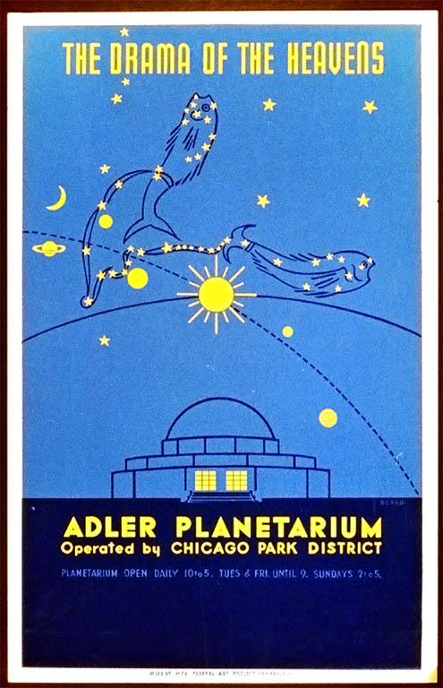
APO and the
Adler Planetarium
Mark Hammergren
APO 20th Anniversary Celebration
May 13, 2014
1939 poster

Slide 2
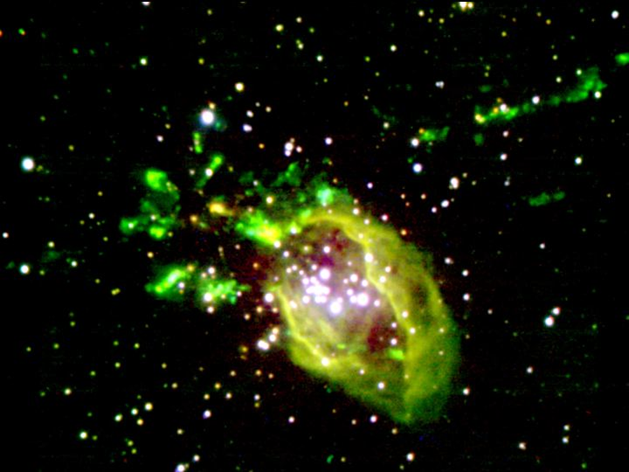
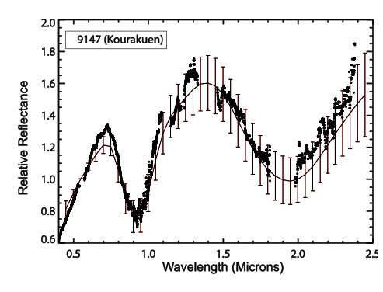
Adler Research and Outreach
Molinari 11
Twilight observing during extended evening hours (ended mid-2000s), observing classes
Two major research programs:
  Star formation (led by Grace Wolf-Chase)
  Confirmation of basaltic asteroids (led by Mark Hammergren)

Slide 3
Near-Earth Object Follow-up and Characterization with ARC 3.5-m
Two year, $1.3M grant from NASA Near-Earth Object Observations (ROSES 2013)
Lease 17% share of 3.5-m (ex U Chicago)
Frequent, brief sessions for astrometric follow-up
Regularly scheduled half-nights, and infrequent Target-of-Opportunity runs on high-priority targets, for physical characterization

Slide 4
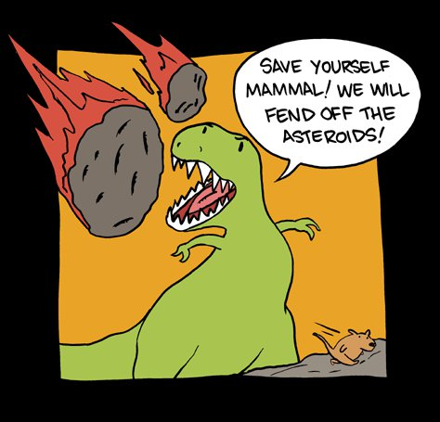
Why NEOs?

Slide 5
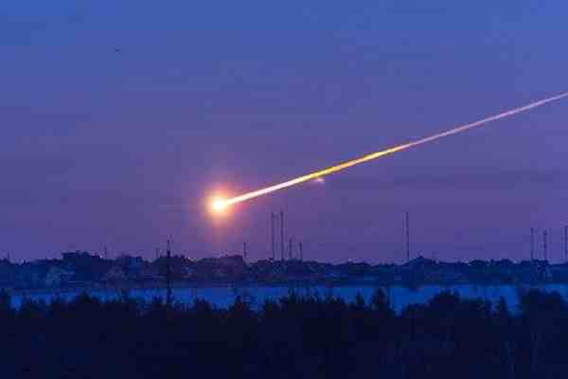

Slide 6
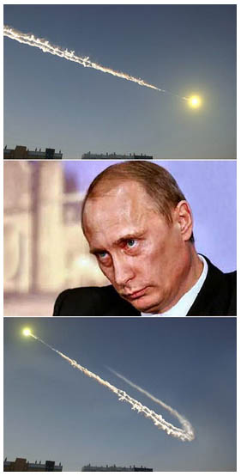

Slide 7
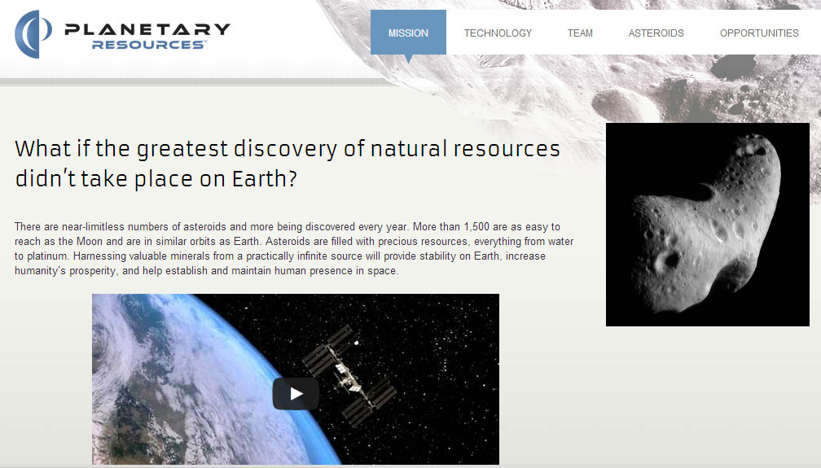
Resources, not just hazards

Slide 8
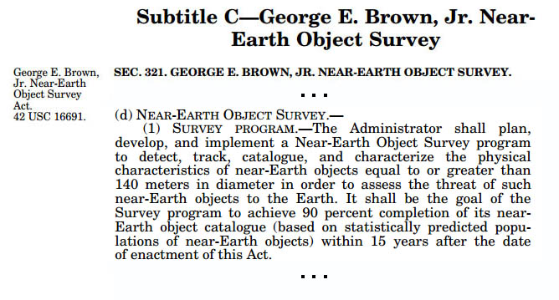
Public Law No. 109-155, enacted 2005
(part of NASA Authorization Act of 2005)

Slide 9
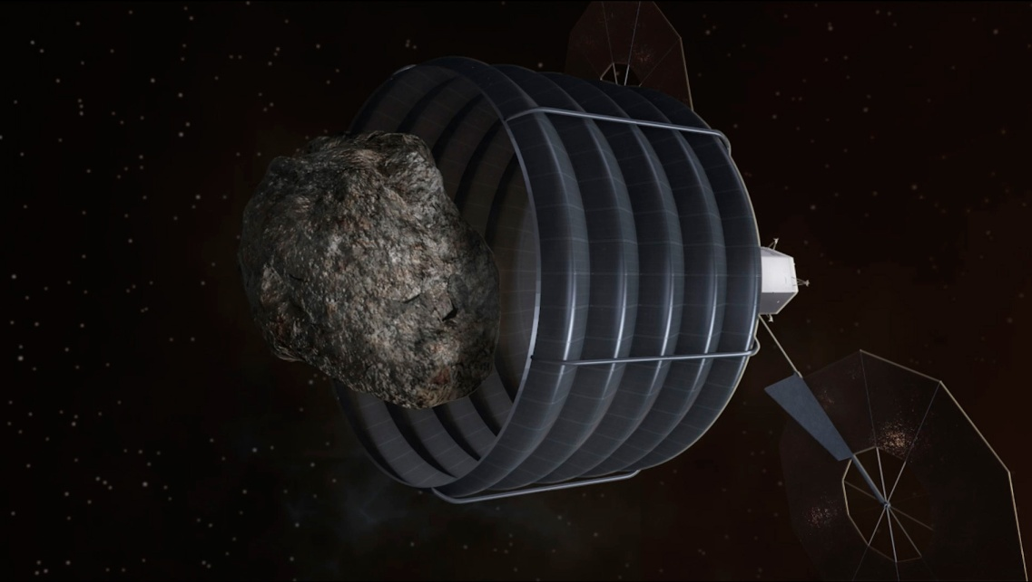
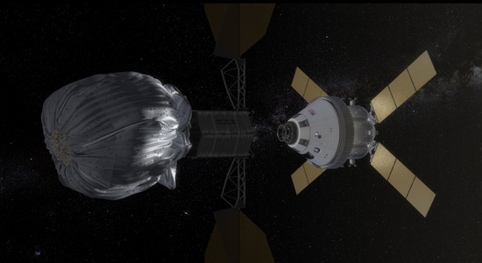
NASA Asteroid Redirect Mission

Slide 10
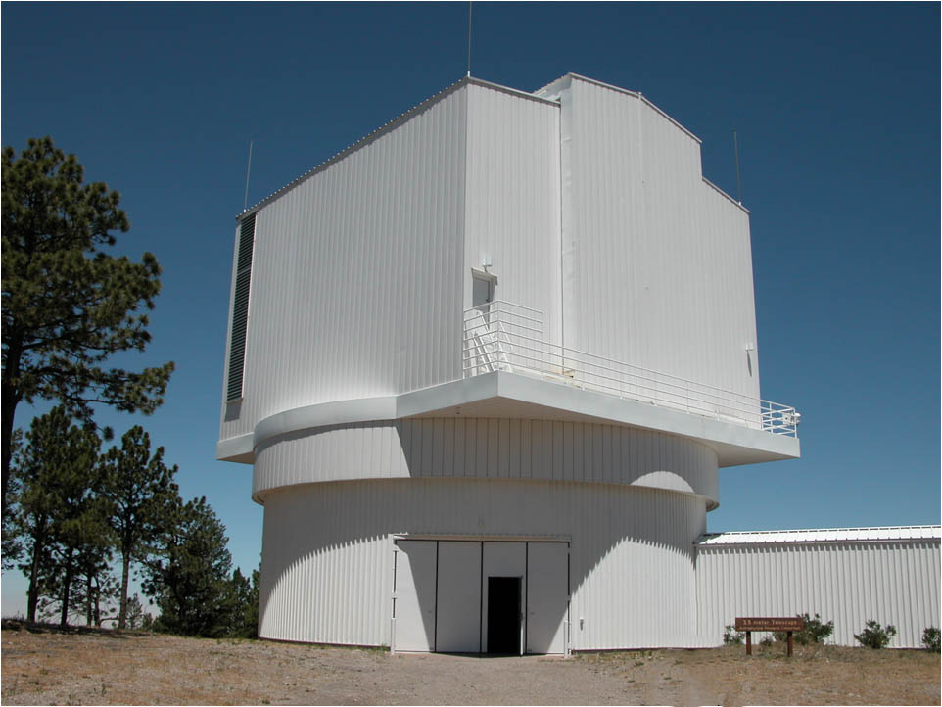
ARC 3.5-m telescope: a uniquely capable facility
Remote observing
  (partial night and ToO scheduling)
Full, rapid-swap suite of instrumentation
Relatively large aperture (for asteroid work)

Slide 11
SPIcam, DIS, ARCTIC imaging
  Astrometric follow-up, multicolor photometry
DIS, TripleSpec
  Reflectance spectroscopy (surface mineral comp.)
Agile high speed imager
  Rotational lightcurves (rotation rate; tumbling?)

Slide 12
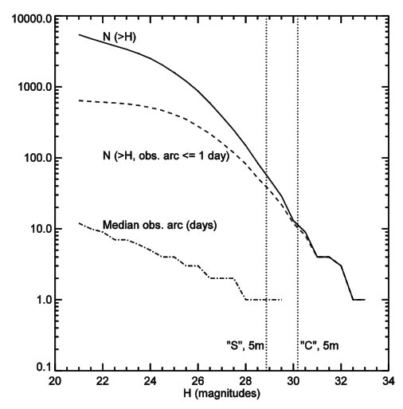

Slide 13
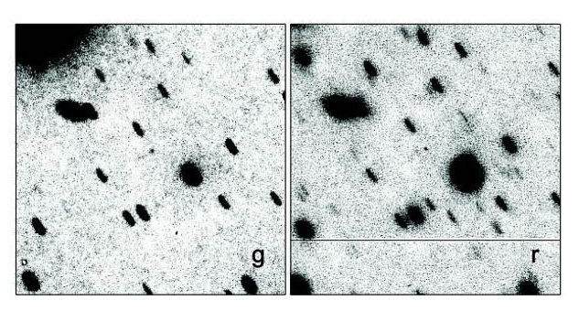
NEO 2013 JC, g ~ 22.6, r ~ 23.0
1 x 5 minute exposure with DIS

Slide 14
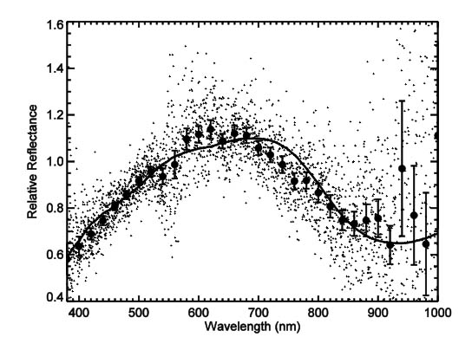
NEO 2013 JM22, predicted V~17.6
1 x 20 minute exposure with DIS (low-res)

